Slide 1
Python Programming UW Robinson Center Summer stretch
Instructors
Xuetao Ma, Bella Chang
TA

Slide 2


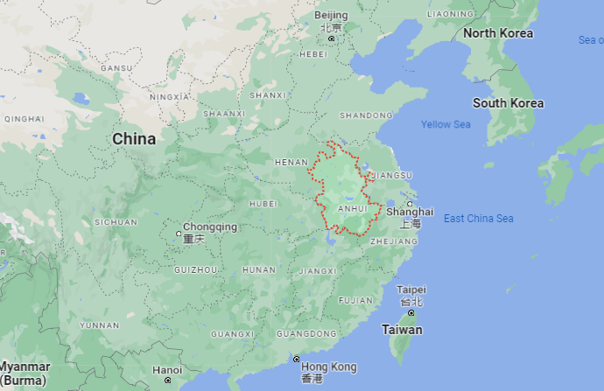
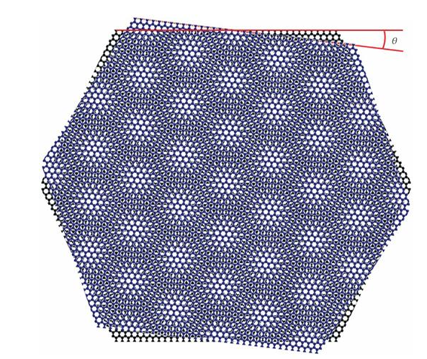
About your instructor
Xuetao Ma
High School: in China
Undergraduate: Purdue University, MSE
MS-PhD: University of Washington, MSE
Research: Transport properties of graphene and twisted bilayer graphene

Slide 3
About your instructor
Bella Chang

Slide 4
Friendly guidelines or agreements
We are together for eight classes!
Our expectations:
We treat each other with respect.
We listen to other’s ideas, and we raise our hands to answer.
If you usually speak up first, choose to go 2nd or last. Encourage others to speak.
We each do our best to learn and ask doubts (there are no silly or dumb questions).
We do our best to enjoy the learning while taking it seriously.

Slide 5
Today’s Topic:
Installing Anaconda
Know various principle of coding
Starting working with Jupyter notebook
Notes:
Scheduling

Slide 6
Major Coding Languages:
What are the coding language that you have heard of?

Slide 7
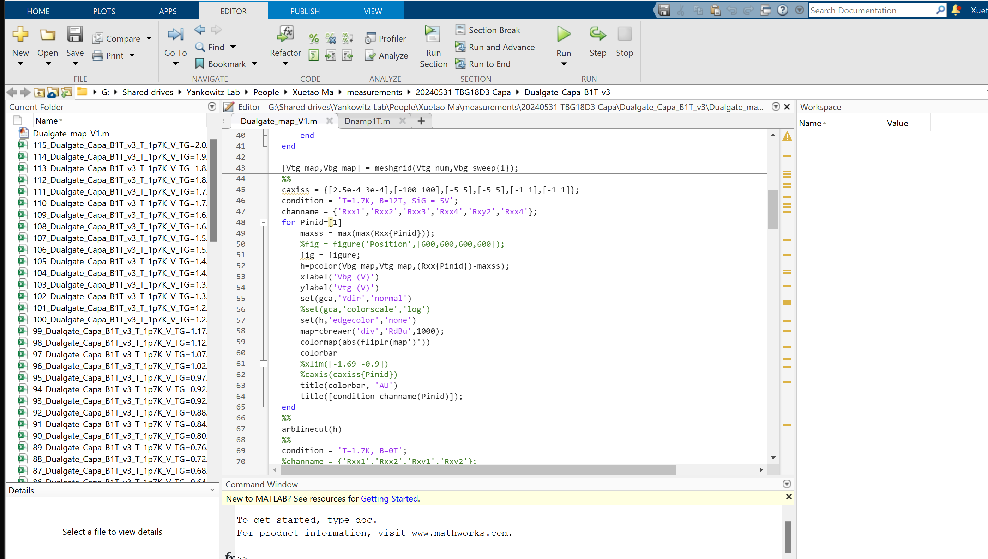
Matlab
Strengths: Primarily used for numerical computing, MATLAB is excellent for data analysis, visualization, and complex numerical computations.
Advantages: Intuitive for mathematicians and engineers due to its mathematical function-based syntax.
Disadvantages: Generally slower than lower-level languages and not suitable for general-purpose programming.

Slide 8
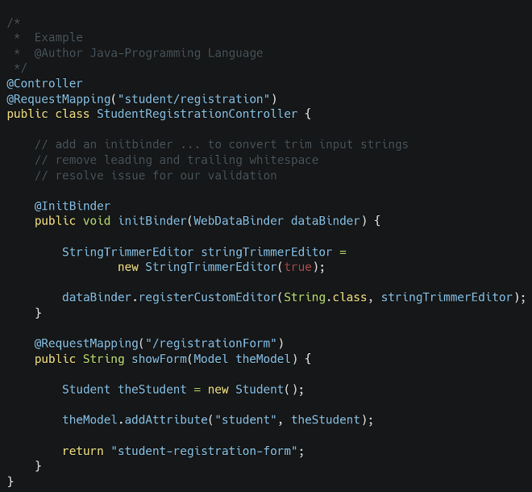
Java
Strengths: Java is a general-purpose, object-oriented language known for its portability across platforms. It's widely used in enterprise environments, mobile applications (Android), and large systems development.
Advantages: Memory management is handled by garbage collection, reducing the risk of memory leaks.
Disadvantages: Can be more verbose compared to other languages like Python, and might be slower than natively compiled languages such as C++.

Slide 9
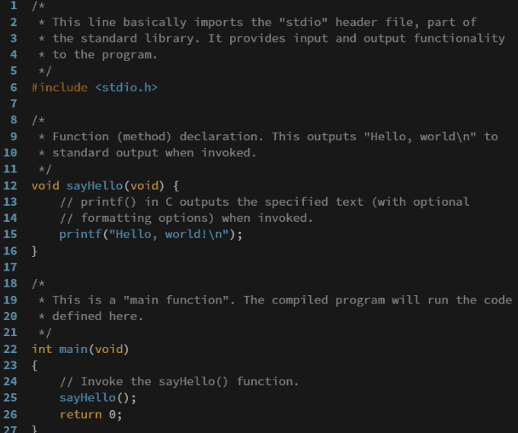
C & C++
Strengths: As a lower-level language, C provides close manipulation of hardware and system resources. It's widely used in system programming.
C++ is commonly used in game development, real-time systems, desktop applications, and systems programming.
Advantages: Offers the power of C with the addition of OOP features. It has a rich function library and works closely with hardware, ensuring performance efficiency.
Disadvantages: Complex language rules and manual memory management can make it difficult to master and prone to errors if not used carefully.

Slide 10
Python
Strengths: Known for its readability and simplicity, Python is a versatile language used in web development, data science, artificial intelligence, scientific computing, and more.
Advantages: Extensive libraries and frameworks (like Django for web and Pandas for data science) make it extremely powerful yet easy to learn.
Disadvantages: It’s an interpreted language, so it might not be the best choice for applications that require optimal performance (e.g., high-frequency trading applications).

Slide 11

Thank you
Thanks to your commitment and strong work ethic
We look forward to working together.
Xuetao & Bella

Slide 12
Working together means we get to know each other
State your name (the name you like to be called)
Tell us your favorite animal/favorite food
What is the latest physics news you read/heard that piqued your interest?
- Please take 5 minutes and go ahead and answer the survey questions on page 1 of your handout.

